Slide 1
AAE 412 Final Presentation
Team 32 - Project F
Brad Lock - Jay Blake - Devin Eubanks

Slide 2

INTRODUCTION

Slide 3
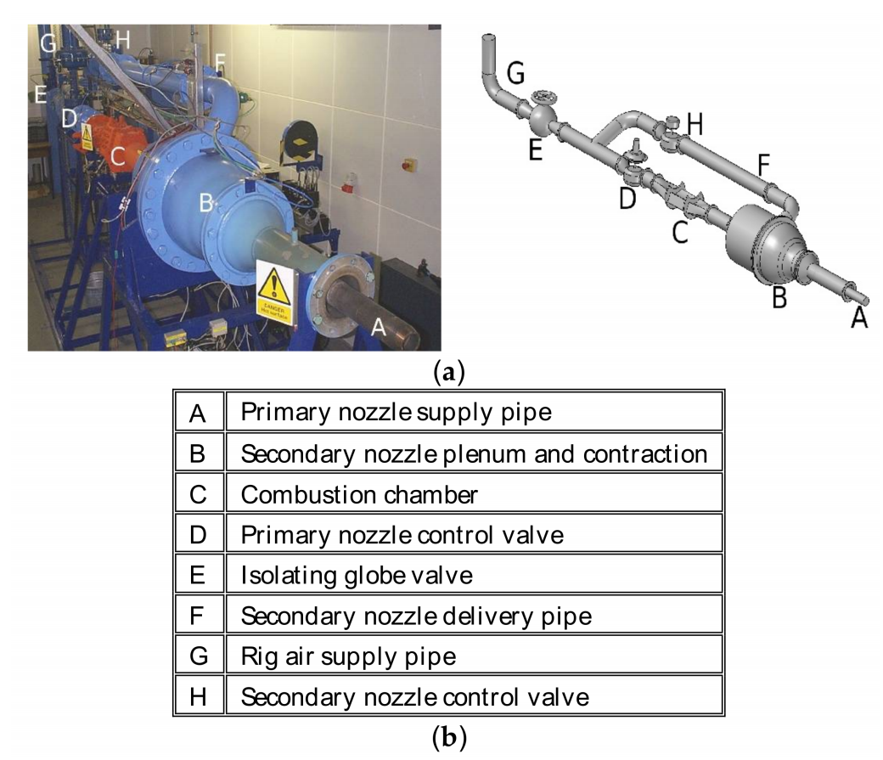
Background and Experimental Motivation
Gather data on near field flow development with different nozzle exit conditions.
Measured flow conditions for 4 nozzles at a variety of pressure ratios.
M. T. Trumper, et al., Influence of Nozzle Exit Conditions on the Near-Field Development of High Subsonic and Underexpanded Axisymmetric Jets, Aerospace, Vol. 5, 2018

Slide 4
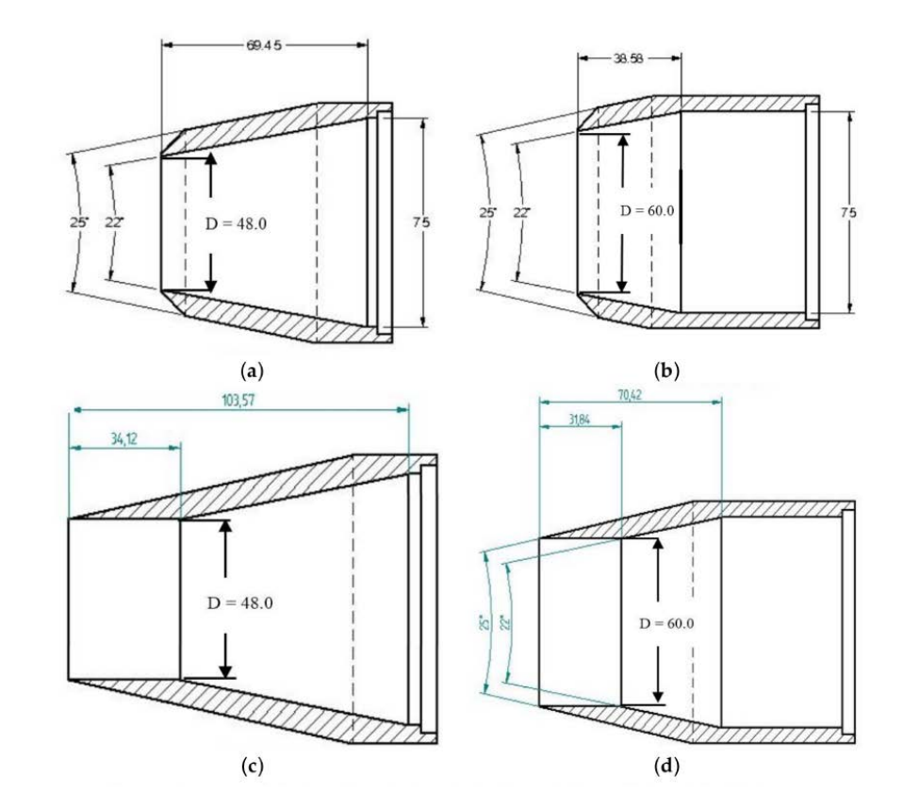
Problem Definition and Project Motivation
Competently model real world experimental results using CFD
3 Cases to compare against experiment
High pressure air through:
Geometry A
Geometry B
Geometry C

Slide 5
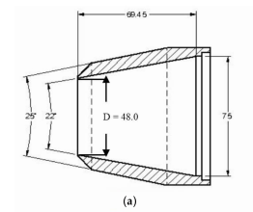
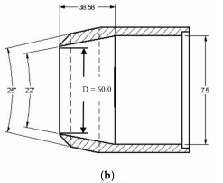
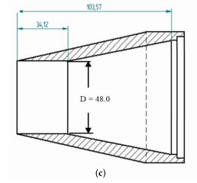
Nozzle Comparison
LU48 (nozzle A)
Converging section to 48mm exit diameter
LU60 (nozzle B)
Converging section to 60mm exit diameter
LU48P (nozzle C)
Converging section to additional section of 35mm length
with non-varying exit diameter, at 48mm
Coarse
Fine

Slide 6
APPROACH

Slide 7

Methods
Domain Sizing
Expanded Grid Space to 20x the radius of pipe.
Grid Sizing
Want to put Y-plus between 30 and 300
At least 10 cells inside BL
Doubled grid spacing in each direction going coarse to fine

Slide 8
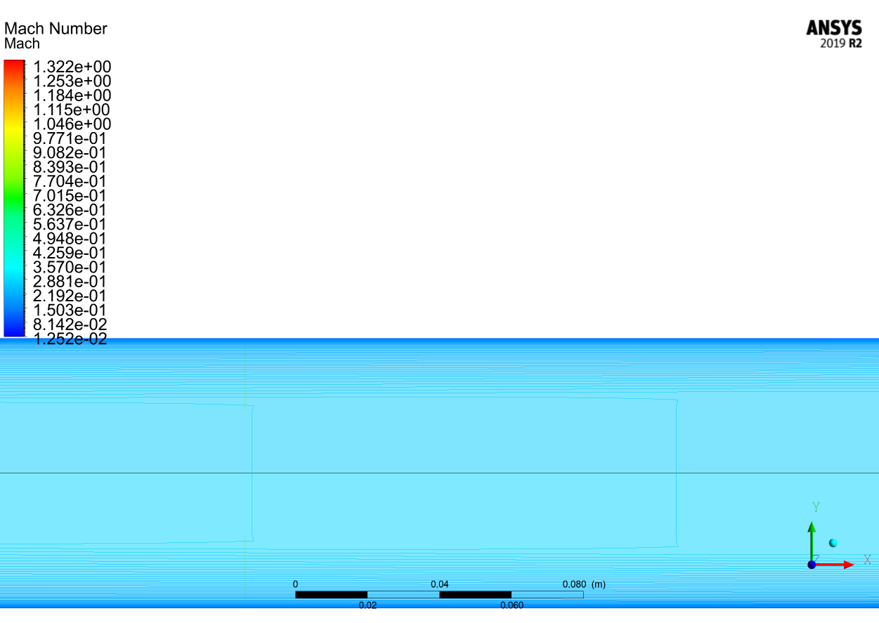
Methods
Finding inlet pipe length
Required BL Thickness at inlet: 29mm
Used initial pipe length of 2m to find x-location of required BL thickness

Slide 9
Physics Set-up
Models:
Energy = On
Viscosity = Realizable k-ε
Control
Type = Explicit
Flow = Second Order Upwind
Boundary Conditions
Nozzle Inlet = Pressure Inlet: p₀= 121590 Pa (g)
Nozzle Wall = wall
Ambient Inlet = Velocity Inlet: V_{axial}= -10 m/s
Far-Field = Pressure Far-Field: p= 20 Pa (g), M = .1
Axis = Axis

Slide 10
RESULTS

Slide 11
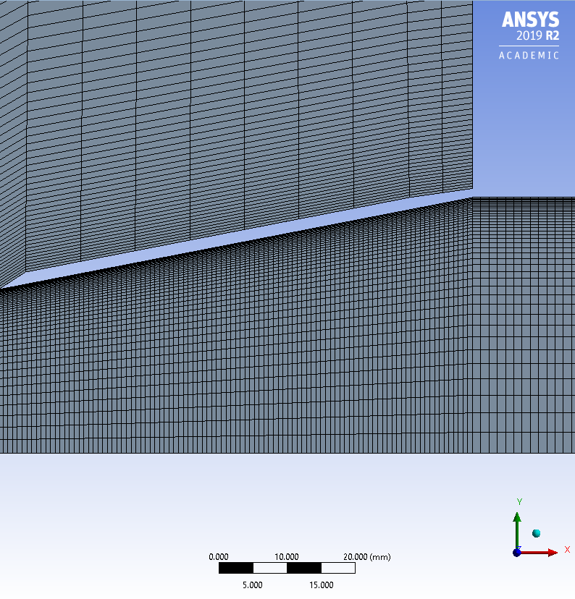
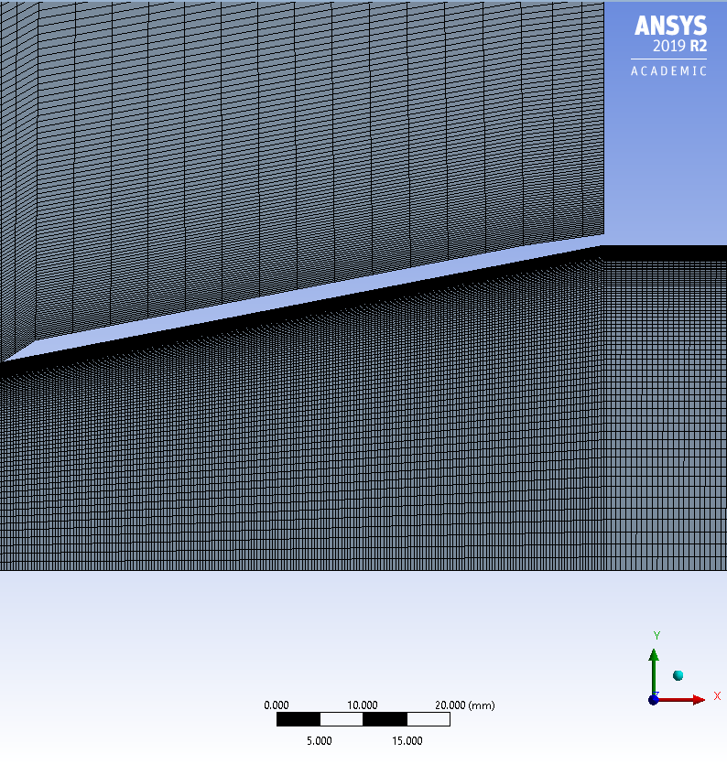
Grid Comparison - Nozzle A (LU48)
Coarse
Fine
Coarse Grid: 60,300 cells
Fine Grid: 237,400 cells

Slide 12
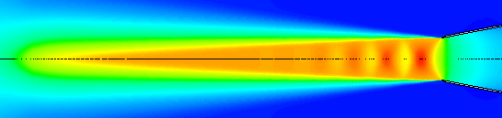
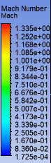
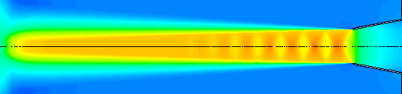
Grid Comparison - Nozzle A (LU48)
Coarse
Fine

Slide 13
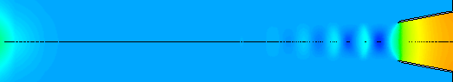
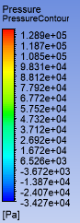
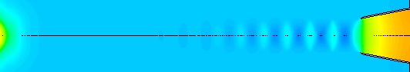
Grid Comparison - Nozzle A (LU48)
Coarse
Coarse
Fine
Fine

Slide 14
Grid Comparison - Nozzle A (LU48)
Qualitative comparison:
Coarse grid renders a wider exhaust plume with lower speeds & pressures
Fine grid reveals a more narrow exhaust plume with higher speed & pressure and a longer plume
Quantitative comparison:
Fine grid divisions increased by a factor of 2 relative to coarse divisions
Maximum aspect ratio for coarse grid: 252.81
Maximum aspect ratio for fine grid: 251.72
Coarse
Fine

Slide 15
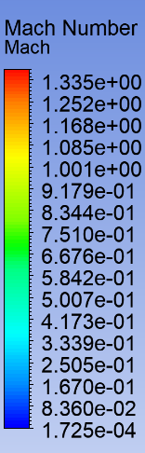
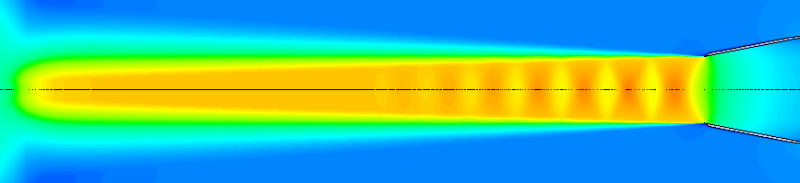
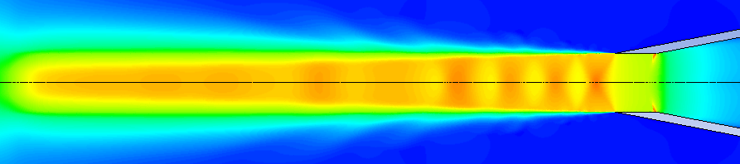
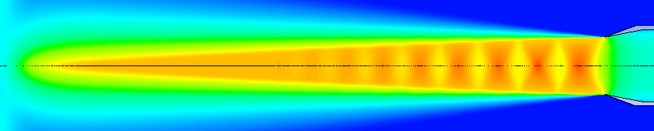
Mach Contours
LU48 (a)
LU60 (b)
LU48P (c)
Fine
Fine
Fine
Nozzles (a) & (c) are of interest in comparison due to same exit diameters but varying geometry
Nozzles (a) & (b) are of interest in comparison due to same geometry but varying exit diameter

Slide 16
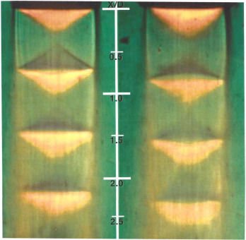
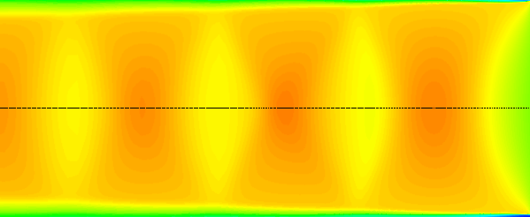
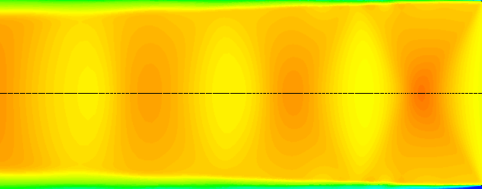
Mach Contours - Cont.
NPR: 2.4
NPR: 2.2
LU48P (c)
LU48 (a)
LU48P (c)
LU48 (a)
Figure 17 from Influence of Nozzle Exit Conditions on the Near-Field Development of High Subsonic and Underexpanded Axisymmetric Jets: Schlieren images from experiment.
Mach contours from simulation conducted.

Slide 17
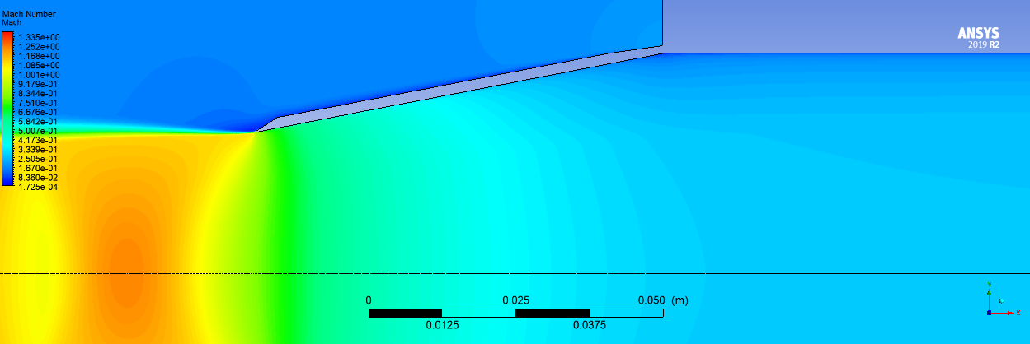
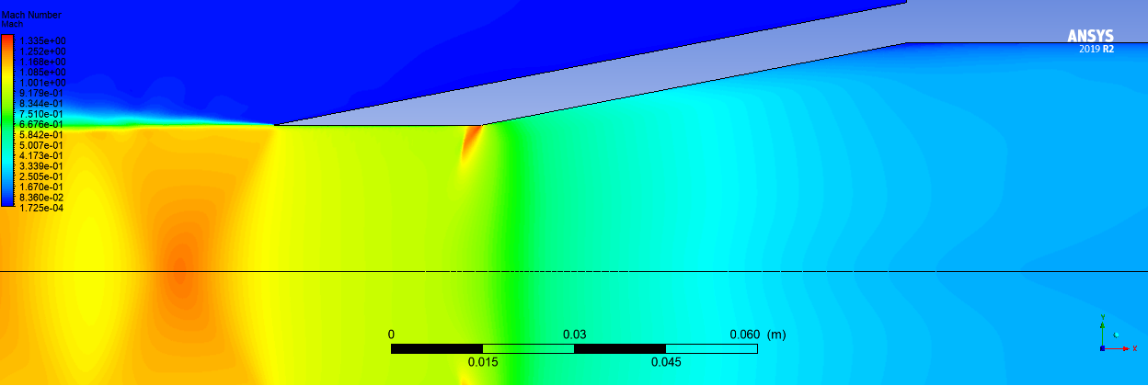
Mach Contours - Cont.
LU48 (a)
LU48P (c)
Mach contours from simulation conducted.

Slide 18
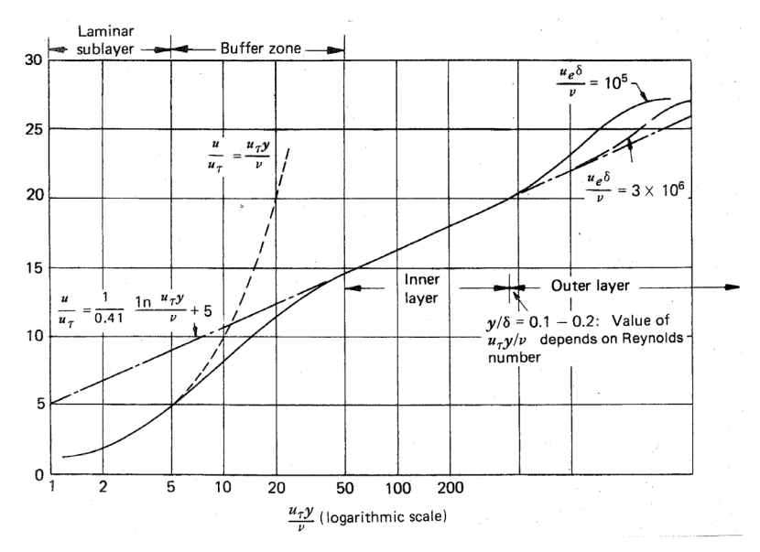
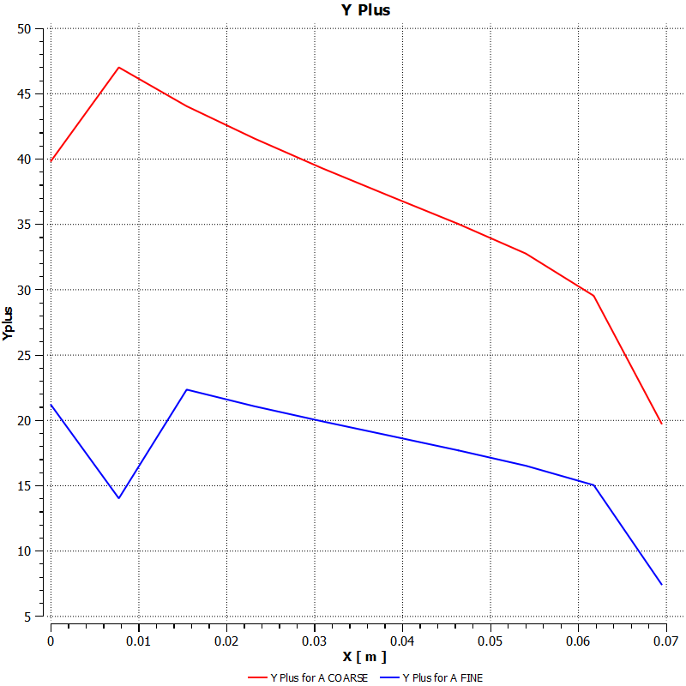
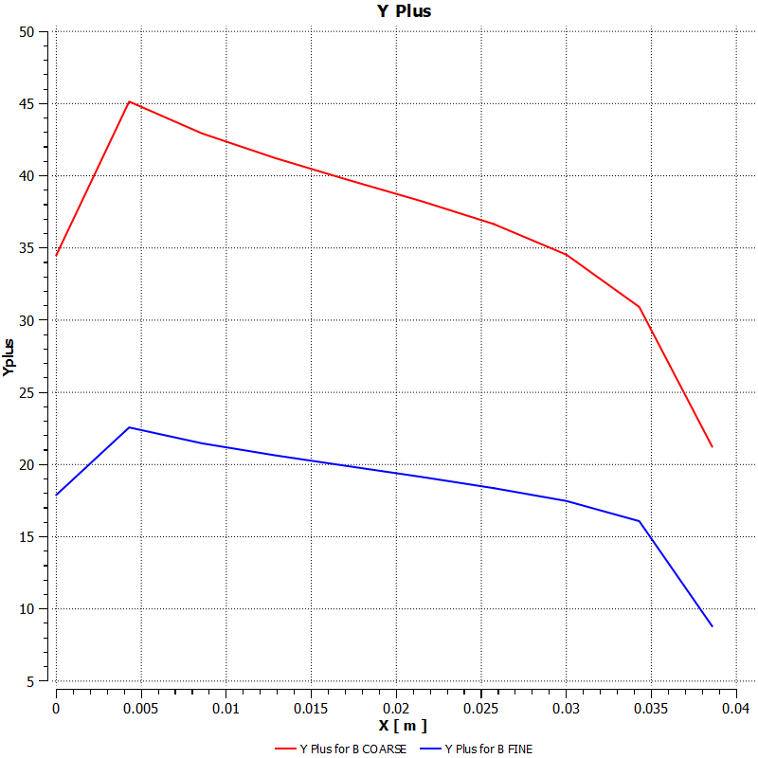
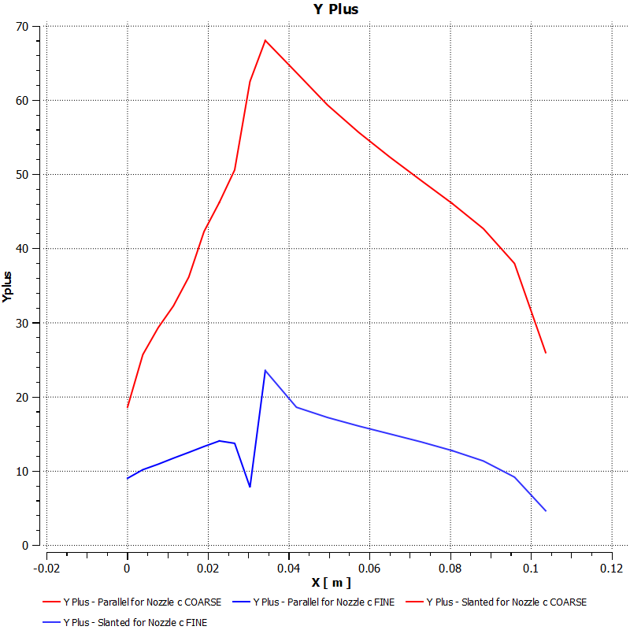
Y-Plus
From AAE 514 - Bane
Coarse Grid
Fine Grid
Nozzle A
Nozzle B
Nozzle C

Slide 19
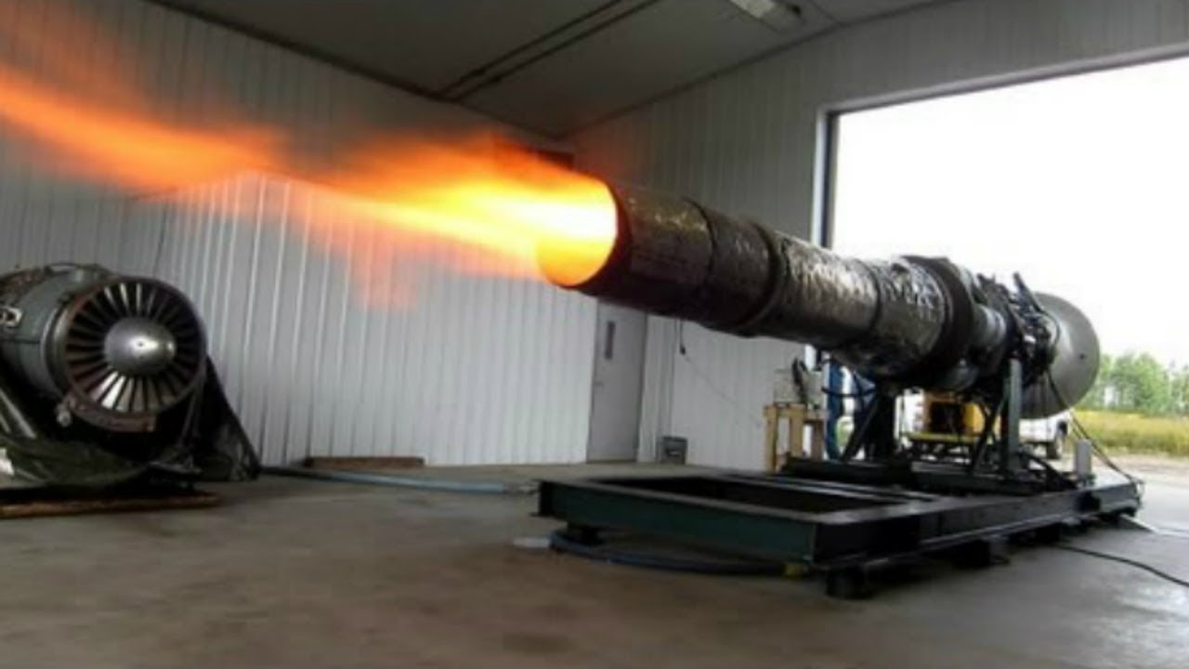
Additional Research- Jet Exhaust
Instead of using air as a working fluid, there was motivation to use a chemical approximation more comparable to jet exhaust

Slide 20
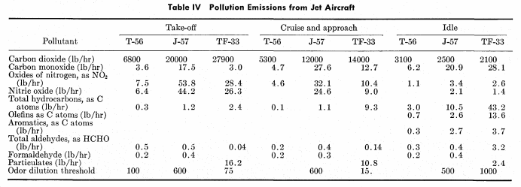
Additional Research - Cont.
From Air Pollution Emissions From Jet Engines (1968) published by The Journal of the Air Pollution Control Association: a table of chemical components of jet exhaust and their respective mass flows in (lb/hr)
As shown in the figure, the mass flow rate for various exhaust compounds are listed for various engines at three throttle settings: take-off, cruise, & idle
Carbon dioxide was selected as the approximating gas due to it being the largest constituent of exhaust flow

Slide 21
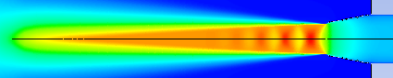
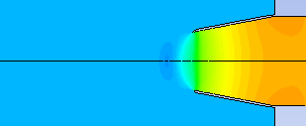
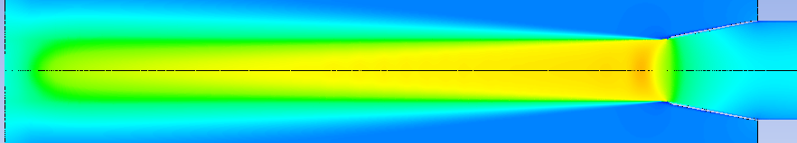
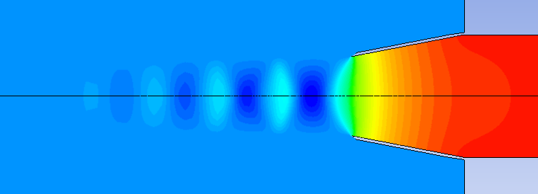
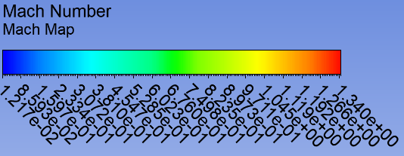
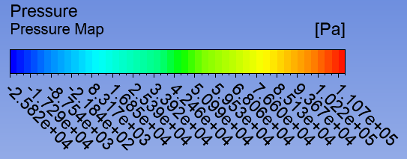
Additional Research - Results
Nozzle A
Air
Nozzle A
CO₂

Slide 22
CONCLUSION

Slide 23
Results Summary
Minor adjustments in nozzle geometry can have a significant effect on the near field flow development
Vena contracta can adversely impact aircraft
Noise, IR signature, and increased potential core of jet
Parallel exit Conditions decrease flow expansion
Wider exit diameter yields thicker jet plume at exit
Quicker decay

Slide 24
CFD/ANSYS Lessons Learned
Attention to detail / all parameters matter
Don’t expect perfect results the first run
CFD is not a full replacement for Experimental data
Nozzle geometry is a critical design consideration

Slide 25
Suggestions for Further Study
Run for more iterations to get to convergence
Adjust grid to keep Y-plus between 30 and 300
More complete encompassment of the experiments scope.
Model jet exhaust for all geometries

Slide 26
References
Eloy R. Lozano , Walter W. Melvin Jr. & Seymour Ochheiser (1968) Air Pollution Emissions From Jet Engines, Journal of the Air Pollution Control Association, 18:6, 392-394, DOI: 10.1080/00022470.1968.10469144
M. T. Trumper, et al., Influence of Nozzle Exit Conditions on the Near-Field Development of High Subsonic and Underexpanded Axisymmetric Jets, Aerospace, Vol. 5, 2018
S. Bane, Turbulent Flows and Boundary Layers, AAE 514, Feb. 2019.

